Slide 1
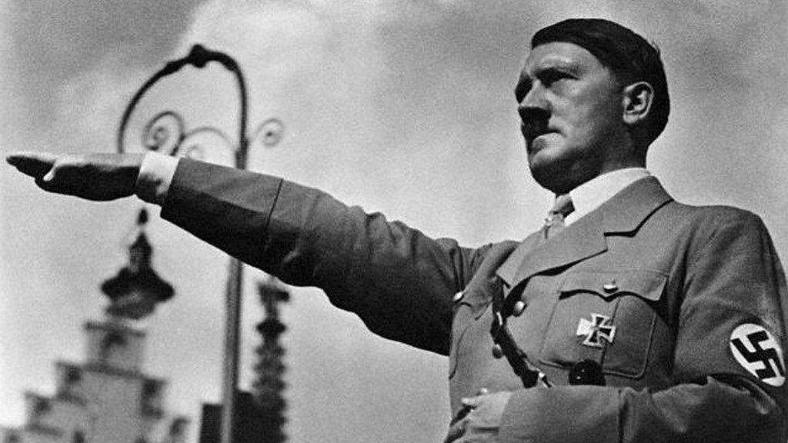
NAZISM AND RISE OF HITLER

Slide 2

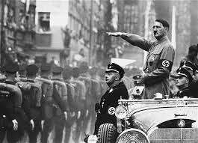
1.NAZISM

Slide 3

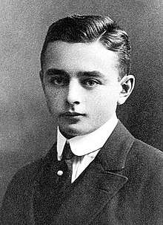
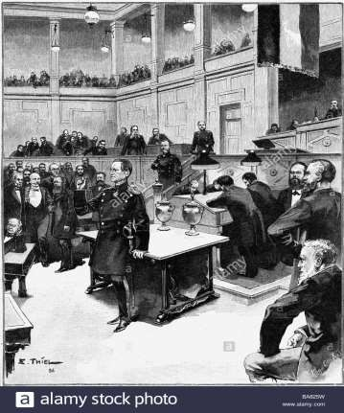
1.1BACKGROUND
In 1945, a 11 year old boy called Helmuth was lying in the bed.
His father was discussing with his wife either to kill himself or all family members.
Next day, his father too them all for a picnic and shot him dead.
Helmuth came to know that his father was a a Nazi and a supporter of Adolf Hitler who wanted to make Germany a supreme power.
Nazism is a structure of ideas about word politics whose leader was Adolf Hitler.

Slide 4
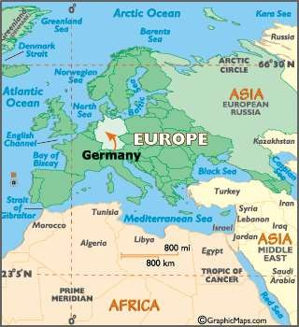
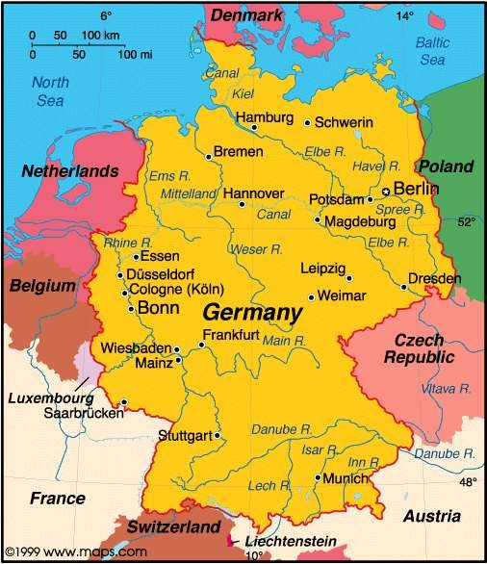

Slide 5

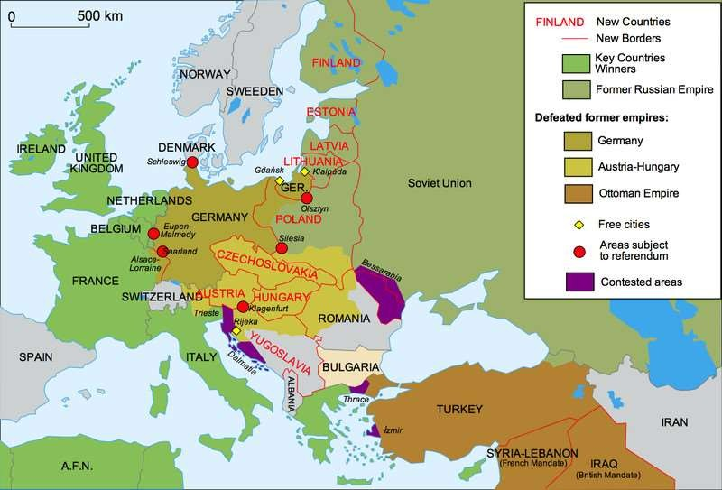
1.2BIRTH OF WEIMAR REPUBLIC
Weimar was a cultural centre in Germany.
Germany fought First World War(1914-1918) against Allies(England, France and Russia).
Germany was able to occupy France and Belgium but Allies were joined by US in 1917 and thus Allies won and Germans were defeated.
Germany surrendered to Allies and Hitler’s propaganda minister Goebbels committed suicide because he did not wanted to share his views with Allies.

Slide 6

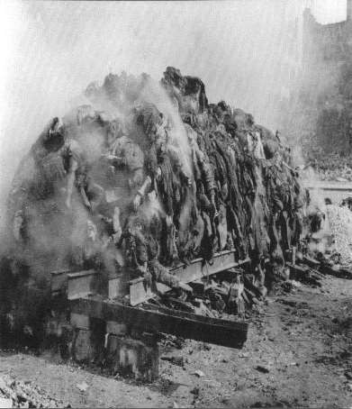
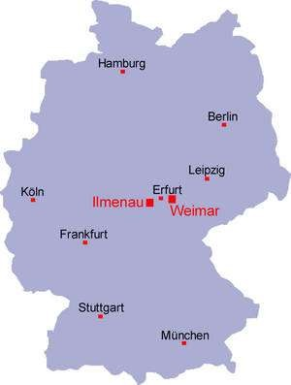
Germany attacked Allies with Genocidal war(a war which killed large number of people).They killed many people putting them in gasing chambers at Auschwitz in Germany.
6 Million Jews, 1 million Polish Civilians 70,000 Germans were killed.
All these actions done by Germany to Allies were called as Crime Against Germany.
A National Assembly was met at Weimar to develop parliamentary structure for Germans. This German parliament is called Reichstag in which everybody was asked to give vote equally including women.

Slide 7
A peace treaty was signed at Versailles wit Allies by Germany. It was a harsh treaty .
In this treaty they passed a War Guilt Cause in which they held Germany responsible for the war and the damage caused to people.
Allies demilitarised Germany, occupied their mineral rich area Rhineland.
It is because of this treaty Germany lost its overseas colonies, 13 % of its territories to France, Poland and Denmark.

Slide 8

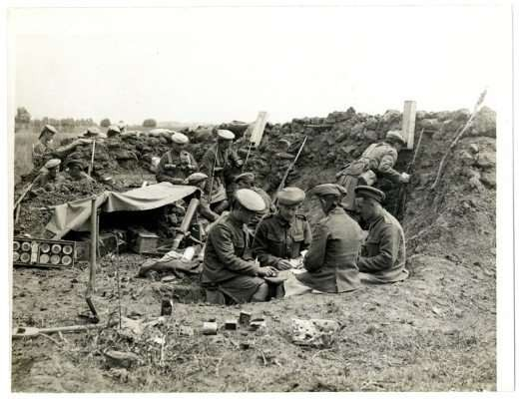
1.3EFFECTS OF WAR
1.First World War( 1914-1918) left a deep impact on European Society.
2.Soldiers were placed above the civilians. Politicians motivated them to raise their voice.
3.The truth was that soldiers lived a miserable lives in trenches, trapped with rats feeding the corps but publically they were shown that they share good position. Therefore, politicians were asking them to raise their voice.

Slide 9
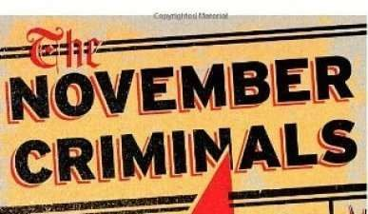
4.First World War have a financial impact on Germany. All its overseas colonies, territories were lost as Germans killed massive people in Genocidal War. They carried the war guilt and were forced to pay compensation to Allies.
5.Many Socialists, Catholics supported Germans.
Those who supported Germans were called as ‘November Criminals’ by the Allies.

Slide 10
1.4 POLITICAL CONDITIONS IN GERMANY
1. People in Berlin(now a capital of Germany) made a rally for Soviet Style Governance. It is government formed of Soviets(workers) like Bolsheviks. There rally was called Spartacist League.
2.Those opposed to this met in Weimar demanding democratic form of government. They formed a organisation called Free Corps. The Spartacists found a Communist Party of Germany.

Slide 11
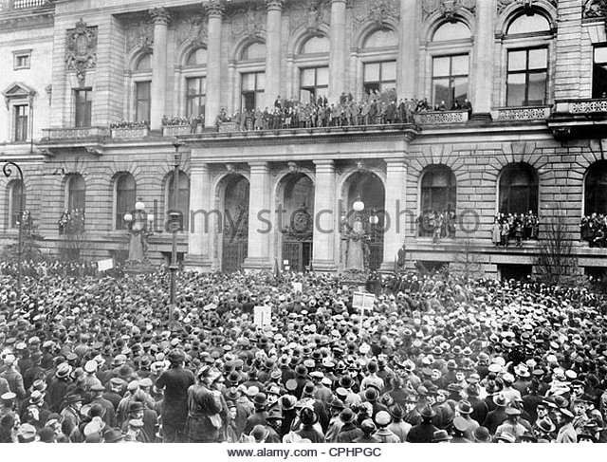

Slide 12
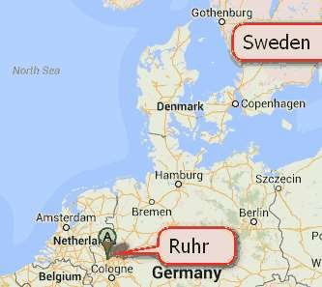
3.These political conditions arised due to economic crisis in Germany.
4.Germany took loans fighting for war and to repay the loan back in the form of gold. Some gold reserves were already occupied by Allies.
5.Germany refused to pay compensation to French after the lost the war. French occupied their famous industrial area called Ruhr coal field.
6.Germany started paper currency after they lost their coal field to French. Because of its paper currency, its value of money fell and US dollar rose from 24000 marks till 98,860,000 marks till December.

Slide 13
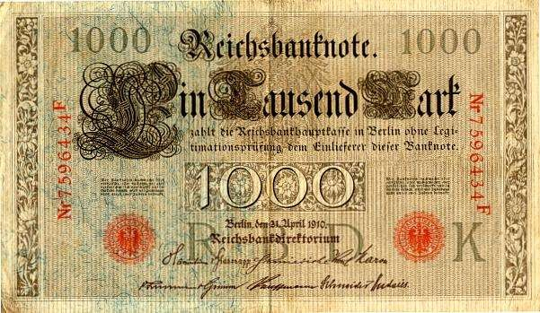
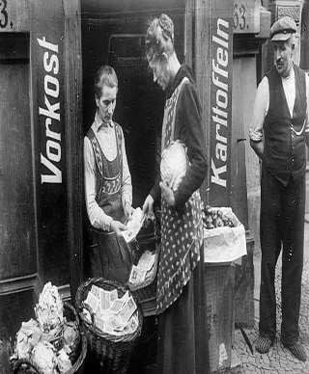
7. Germany carried this paper currency for even buying a loaf of bread. The prices of the things increased and due to loss of value of their currency, this crisis is called as Hyperinflation in which prices rise phenominially high.

Slide 14


1.5 YEARS OF DEPRESSION
1.Year 1924-1928 were stable years
.Germans got short term loans from USA.
2.In 1929, the Wall Street
Exchange(World’s biggest stock Exchange) crashed.
3.People started selling their shares. This was start of Great Economic Depression.
4. in 1929-1932, national income of USA fell by half. Factories were shut down, exports fell down and many investors withdrew their money back.

Slide 15
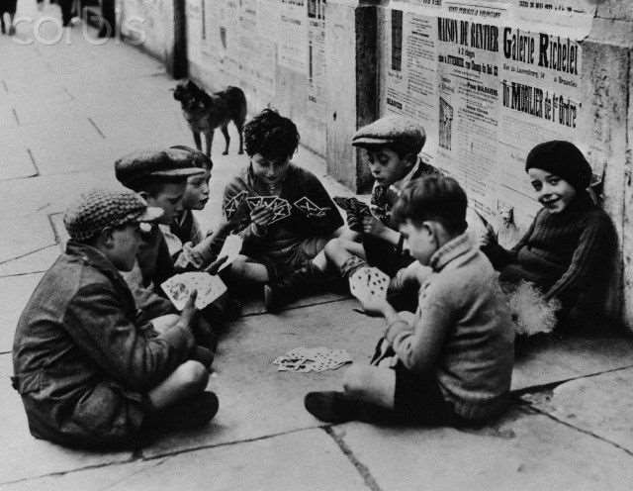
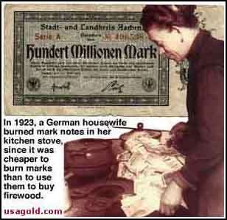
In Germany in 1932, industry production reduced to 40%. Workers lost their jobs and were paid less wages. Many people in German were seen on streets saying “Willing to do any work”.
Unemployed youth played cards, sat on street corners. Youth got involved in criminal activities.
German people were living in anxiety, fear. Salaried employees thought their savings will diminish if their currency lost value. This state of anxiety by salaried employees is called proletarianisation in which salaried employees considered them salaried umemployed.

Slide 16
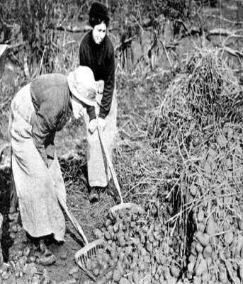
7. Agricultural practices also fell down and women were not able to fill the stomach of their children with food.
8.People of German were not satisfied with democratic parliamentary system. This gave rise to dictatorship.
9.many coalitions(groups) were formed.
10.Article 48 was passed which gave President the power to impose emergency, suspend civil rights. Because of this passing article 20 different cabinet was formed in 239 days.

Slide 17
2.RISE OF HITLER

Slide 18

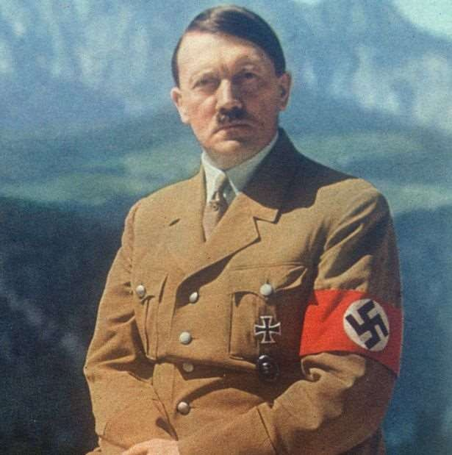
2.1 HITLER RISE TO POWER
1. Crisis in Economy, Political Conditions and Society formed background to Hitler rise in power.
2. Born in 1889 in Austria, he acted as a messenger in Army after First World War and earned various metals for bravery.
3. Hitler was very tensed about Germany about Versailles treaty.
4. In 1919, he joined a small group called German Workers' Party and renamed it as National Socialist German Workers' Party which later came to be known as Nazi party.

Slide 19

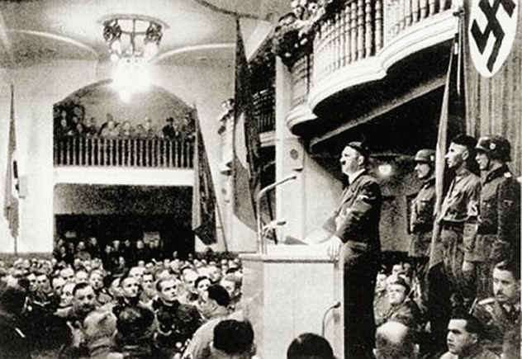
5.Nazis could not effectively mobilise people support till 1930. It was during Great Depression when banks collapsed and workers lost their job people started having hope in Nazi programme. By 1932 this party largest party with 37 percent votes was formed.
6. Hitler was a powerful speaker. His passion and words moved people. He promised providing employment for those looking for work, secure future for youth, restore dignity of Germans.

Slide 20
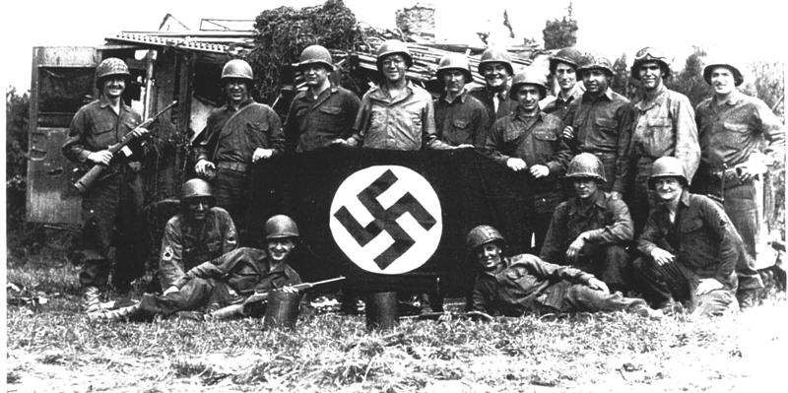
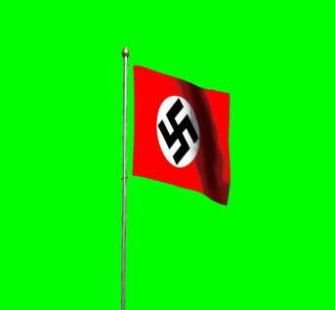
7. Hitler devised a new style of politics . He understood the significance of rituals , mass mobilisations. He took rallies, public meetings to instil unity among people.
8. Nazis took red banners with Swastika to create unity among the people to support the Nazi party. Hitler was seen as a messiah or saviour by Germans who was trying to help them in difficult situations.

Slide 21

2.2 Destruction of Democracy
1. On 30 Jan 1933, President Hindenburg offers Chancelorship of all cabinet ministers to Hitler.
2. Having got power, Hitler broke the democratic structure of Government.
3. The Fire Decree was passed on 28 Feb 1933 which suspended all civil rights like freedom of speech, press, assembly that was guaranteed by Weimar Constitution.
4. Various communists started concentration camps who raising their voice against the Fire decree passed by Hitler.
5. On 3 march 1933, Enabling Act was passed which passed dictatorship in Germany. It gave all powers in hands of Hitler. All political parties except Nazi party were banned.
6. Nazi created their own security forces to exercise control over people. It include SA or Storm Troopers, Gestapo (Secret State Police), SS(Protection Squads), Security System(SA) and regular police in green uniform

Slide 22
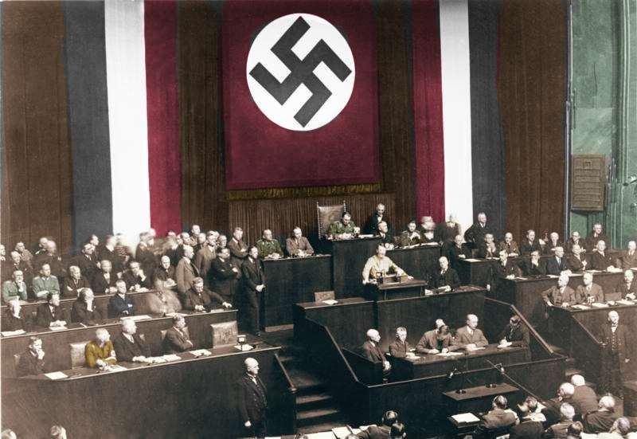

Slide 23

2.3 Reconstruction of Germany after Hitler gained power
1. Hitler assigned the responsibility of Economic recovery to economist Hjalmar Schacht who aimed at full production of goods in industries, employment to people etc.
2. Hitler made foreign policy in which he invited various League of Nations in 1933. After this policy, he occupied Rhineland in 1936 joined Austria and Germany in 1938 with the slogan ‘One People, One Empire One Leader’
3. He than wanted to occupy Germany speaking state i.e Sudentnland. Scacht advised him not to do so as they don’t have enough finances. Hitler did not agreed to Schacht’s view so he left him.
4. Hitler was of the opinion that economic crisis can be recovered through collection of resources from expansion of their territory.
5.in Sept 1939, Germany invaded Poland and started war with France
and England.

Slide 24
6. In Sept 1940, Triparite Pact was signed between Germany,Italy, Japan Strengthening Hitlers claims to international power. By the end of 1940, hitler reached at a height of power and being famous.
7. Hitler now wanted to conquer Eastern Europe. He attacked Soviet Union in 1941. Soviet defeated German at Stalingrad and occupied Germany till Berlin.
8. USA resisted on entering into war as it had already faced economic depression after First World War and thus with fear did not wanted to enter into war.
9. Japan joined with Germany and bombed US base at Pearl Harbor. In order to take revenge USA entered into Second World War which ended in 1945 with Hitler defeat and US dropping bomb at Hiroshima in Japan.

Slide 25
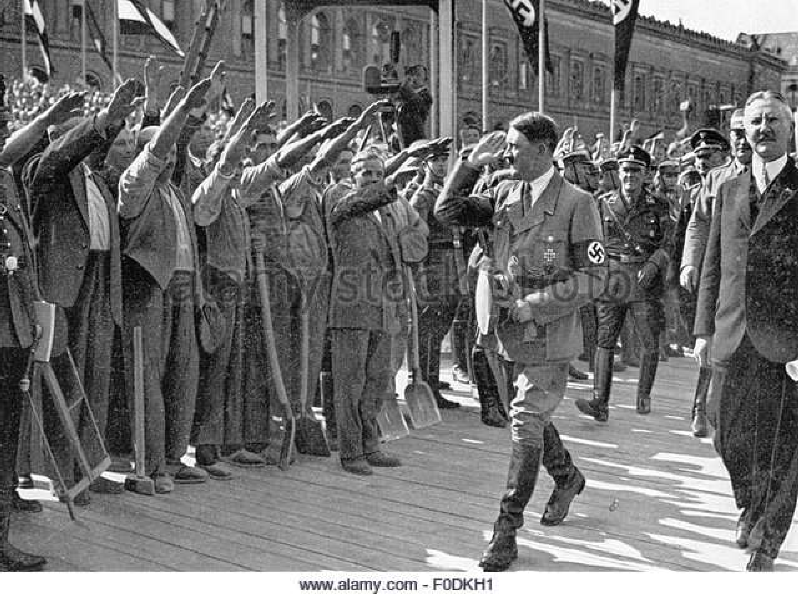

Slide 26
3.NAZI’s IDEOLOGY
1.According to Nazi’s there was no equality among people. People were arranged on the basis of races. Blue eyed German Aryan on top, mix coloured people in middle and Jews on lowest.
2.Hitler followed the policies of racism of Charles Darwin and Herbert Spencer. Charles Darwin explained the concept of evolution of plants and animals and Herbert Spencer told about the survival of the fittest( one who adapts himself to the changing conditons).
3. Nazi’s believed on theme “Strongest race would survive and weak would destroy” therefore for Nazis Aryans were stronger race therefore placed on top.
4. Nazis also believed in the concept of Lebensraum i.e living space. They believed in annexing the other territories for living. This new land can be used by people to live and provide resources to nation.

Slide 27
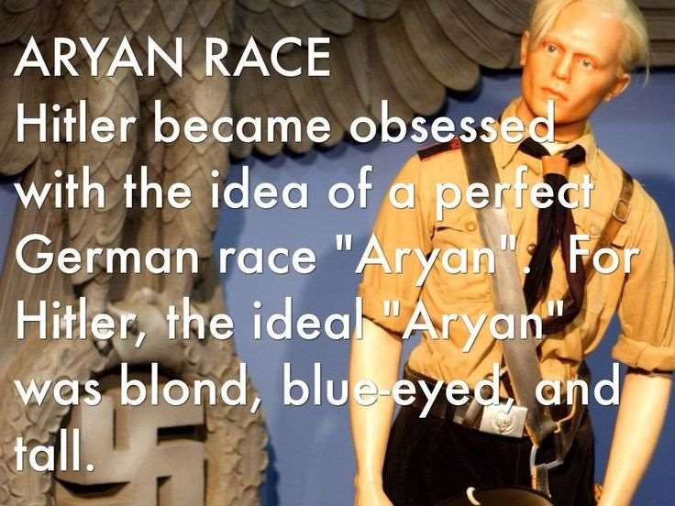
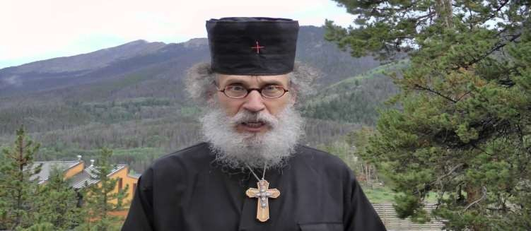

Slide 28
3.1Establishment of Racial State
After getting power and practising ideology in the state , Nazis started creating the separate racial state .
Nazi’s considered pure, healthy Nordic Aryans as desirables for Germans and Jews, Gypsies, Blacks were considered as undesirables.
Jews were treated very badly in Germany. They were considered as killers of Christ. They were stopped from buying any land, survived through trade and money lending and lived in a separate areas called as GHETTOS.
Poland was annexed by Germany and the POLISH were asked to leave their land and resources for Germany.
Discrimination was done with Polish civilians children. Those children who looked like Aryans were snatched from their mother, examined by race experts and they passed the race test they were part of German family or else sent to orphanges.
•

Slide 29
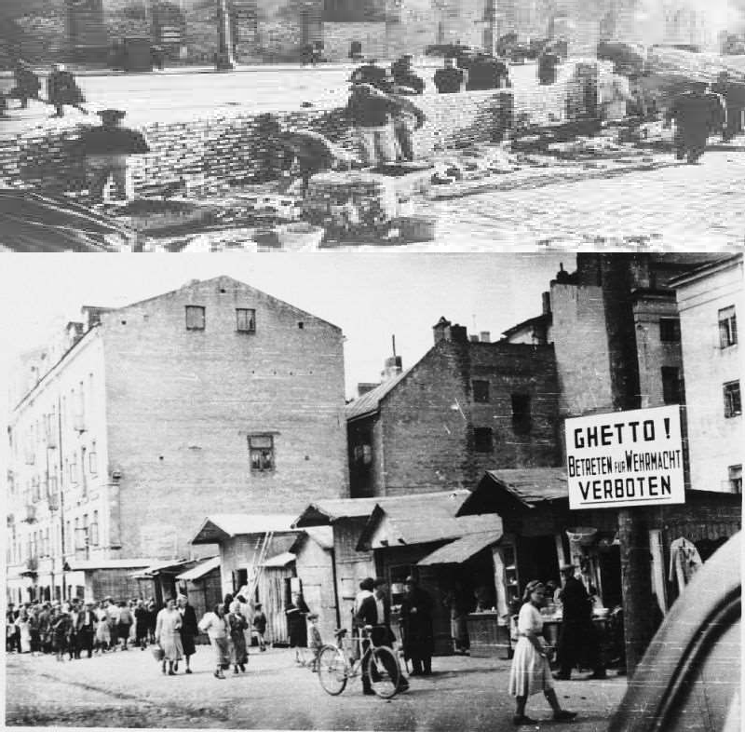

Slide 30
4.Youth in Nazi Germany
1.Hitler believed that youth are the future of the country. They believed in teaching children Nazi ideology from starting.
2.Schools under Nazism:
2.1Jews teachers were considered politically unreliable and were dismissed.
2.2Germans and Jews children were seperated. Jews Children were thrown out of school and later sent to gas chambers.
2.3School textbooks were rewritten to introduce Nazi’s idea of race to all
2.4Children were taught to hate Jews and worship Hitler
2.5 Sports of aggression like boxing was taught which could make them strong and determined.
2.6 various Youth organisations were formed. 10 years old had to move in Jungvolk( nazi youth group of children below 14 years of age), at 14 they have to join Nazi youth organisation called Hitler Youth where they learnt worship war, aggression , hating jews, , physical training etc and joined armed forces at age 18. this party of youth was renamed Hitler youth in 1922.

Slide 31
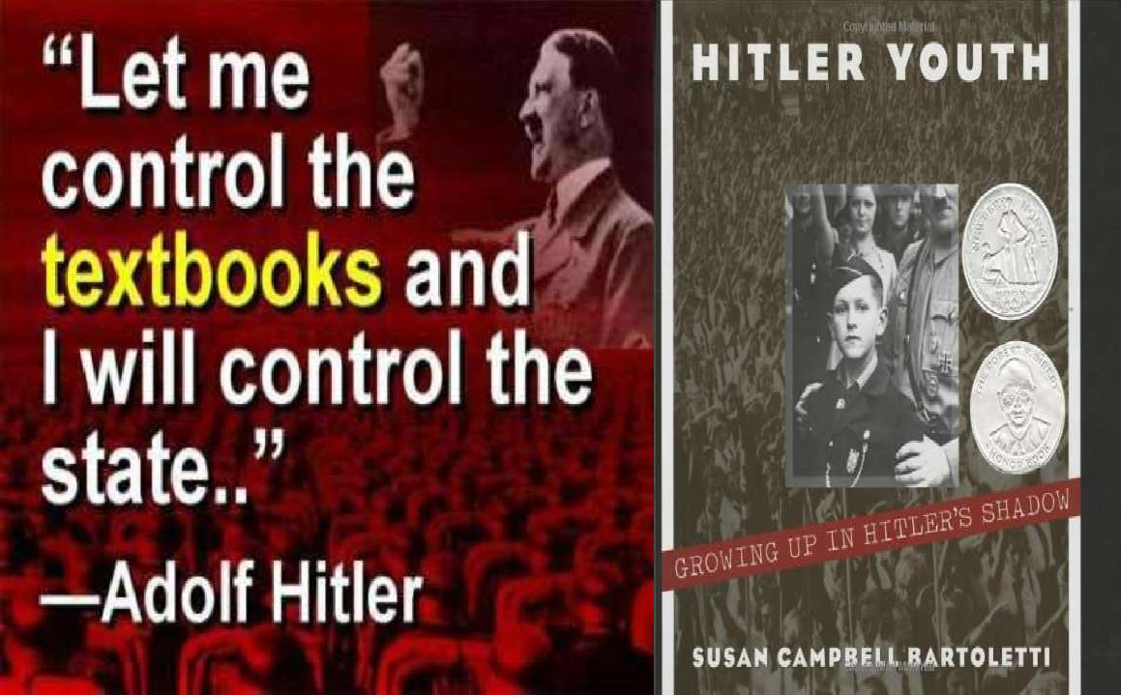

Slide 32
2.7 Indiscrimination with Women.
Children were taught that women are different from men . Males were taught to be masculine, strong hearted and girls were asked to be good mothers of Aryan Children. Women who gave birth to racially desirable children i.e. Aryans were awarded, given good treatment in hospitals.
Aryan mother children were given concession in shops, theatre tickets and railway stations
To encourage more child birth, Honour crosses were provided i.e bronze cross for 4 children and silver for 6 children and gold for eight or more.
All aryan women who maintained contact or talked with jews, Poles or Russians were paraded through town with shaved heads, black faces and with a card in their necks”I have sullied the honour of the nation’

Slide 33
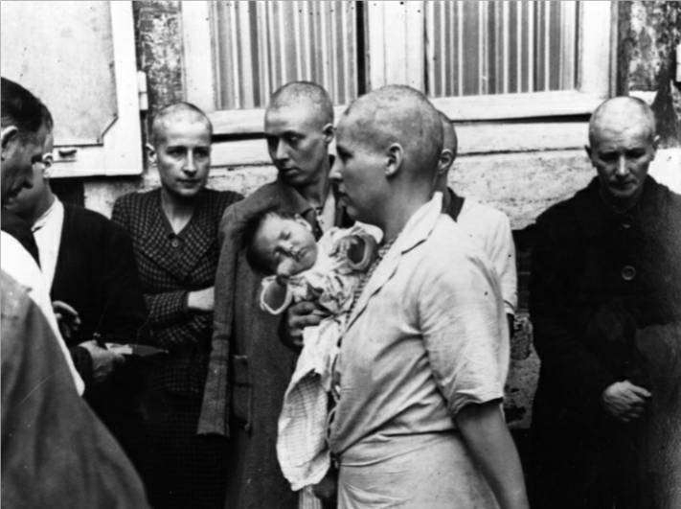
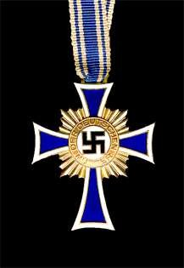

Slide 34
Art of propaganda(providing information to public)
Nazis used different words for different processes. Mass killing was called special treatment, killing of Jews was called Final Solutions, killing of disabled as Euthanasia, Gas chambers were called as disinfected areas.
Nazis uses film, radios , catchy slogans, leaflets to address public. Nazis made a film called The Eternal Jew in which they showed orthodox Jews, referred to as rats. Through this picture they want to tell people that Jews are undesirable in society. Common people started treating Jews also as bad people. Houses of Jews were marked as suspicious neighbors.
One of the Jews writer secretly wrote about the plight of Jews in book called Third Reich of Dreams in which he wrote how Jews committed suicide instead of going to gas chambers and calling themselves as Nazi.
After when Germany got defeated from the war, Jews wanted the world to know about the harsh attitude done by Germans to them. All the discriminations done by Germans to Jews was called as Holocaust

Slide 35

Question Answers
Q1.Describe problems faced by Weimar Republic?
A1.1. Weimar, cultural centre of Germany after losing first World War against Allies have to sign a Versailles Treaty.
2. Germany’s overseas colonies, territories, famous area like Rhineland, Ruhr Coal Field were lost as Germans killed massive people in Genocidal War. They carried the War guilt Clause and were forced to pay compensation to Allies in form of Gold.
3.Germany carried this paper currency for even buying a loaf of bread. The prices of the things increased and due to loss of value of their currency, this crisis is called as Hyperinflation in which prices rose very high.
4.Workers lost their jobs and were paid less wages. They were seen on streets saying “Willing to do any work”. Youth got involved in criminal activities.
5. Agricultural practices also fell down and women were not able to
fill the stomach of their children with food.
6..People of German were not satisfied with democratic parliamentary system. This gave rise to dictatorship

Slide 36

Q2. Discuss why Nazism became popular in Germany after 1930?
A2.Nazism was a political system introduced by Hitler to establish dictatorship in Germany.
All the problems faced by Weimar Republic gave rise to Nazism becoming popular.
Q3. What are peculiar features of Nazi thinking?
1.According to Nazi’s there was no equality among people. Men and women were different from each other.
2.People were arranged on the basis of races. Blue eyed German Aryan on top, mix coloured people in middle and Jews on lowest.
3. Nazi’s believed on theme “Strongest race would survive and weak would destroy” therefore for Nazis Aryans were stronger race therefore placed on top.
4. Nazis also believed in the concept of Lebensraum i.e living space. They believed in annexing the other territories for living. This new land can be used by people to live and provide resources to nation.
5. Hitler believed that youth are the future of the country. They believed in teaching children Nazi ideology from starting i.e menand women are not equal
6They believed that Jews are the biggest enemies and thus many films like the Eternal Jew were made to tell common people that Jews are undesirable in society.

Slide 37
Q4. Explain why Nazi propaganda was effective in creating a hatred for Jews?
Nazis believed in the racial society in which Aryans were on the top and Jews were the lowest.
Jews were affluent traders and moneylenders. After the Economic depression, Germans lost their jobs but still these Jews were economically sufficient which started creating hatred among people.
Nazis used various forms of media like newspapers, posters, catchy slogans etc. to create hatred against the Jews in the mind of common public and Germans.
Nazis believed in training the young children with their philosophy of racialism as young population is the asset for the country. This is turn helped them creating more hatred against the jews.
Nazis used codes like final solution for Jews , Euthansia for disabled etc to show Jews were inferior to all.

Slide 38

Q5. Explain what role did women have in Nazi society?
A5. women in Nazi society were not considered equal to men and were asked to do the household work and be good mothers of Aryan Children.
Women have to maintain purity of race, keep distance from Jews and teach their children about the Nazi values.
Hitler followed the principle of majoritism in which women were encouraged to produce more children. Honor crosses were awarded to women. A bronze medal for 4 children, silver for six children and gold for eight or more.
Women who gave birth to desirable children were awarded and other were punished.
All women have to follow this code of conduct and if
they didn’t follow , their heads were shaven , face were made black and moved on streets.

Slide 39
Q6. in what ways did Nazis state seek to establish total control over its people?
A6. Nazis used various techniques for exercising control over its people:
1. All parties were banned and a new party called Nazi party was formed which promised the employment to all people.
2.Nazis used war and occupying the other territories as way to remove economic crisis in the country and expand their area under power.
3. Hitler introduced various security forces to exercise control over people. It include SA or Storm Troopers, Gestapo (Secret State Police), SS(Protection Squads), Security System(SA) and regular police in green uniform.
4. they created false image of Jews in the mind of common people as Jews were responsible for all the miseries in Germany.
5. Nazis used the policies of racialism in which people were divided on the basis of races and common people were taught the principle of inequality that men are not equal t women.

